Slide 1
E-Commerce Market Basket Analysis
By,
Rutanshu Desai
MS, Systems Engineering Management (Business Analytics)
rutanshu.desai@utdallas.edu
GitHub: https://github.com/RutanshuDesai
The University of Texas at Dallas

Slide 2
Overview of Project
Performed market basket analysis on UK based e-commerce online store (Online Gift Store) having half-million transactions recorded all over Europe.
Cleaned the data to remove incorrect transactions, identified missing values in Product Description column and deleted those records, removed unimportant transactions like Postages, amazon fee etc.
Performed Data Wrangling to arrange the DataFrame required for the ML algorithm.
Used Python and mlxtend Machine Learning library to do Association Rule Mining and find purchasing patterns.
Used R-Studio to cross-verify the results (used ‘arules’ package and R programming). The python file in GitHub repository contains a snippet of R code.
Explained the meaning of Support, Confidence and Lift to interpret the data mining results.
Used Tableau to gain insights regarding which days and at what time do people mostly purchase from the online website. (Check the presentation in the GitHub repo)
Recommended bundling of products and suggested offers to be given on specific days to boost-up the sales.
For details on Python codes, visit my GitHub project file - Market Basket Analysis

Slide 3
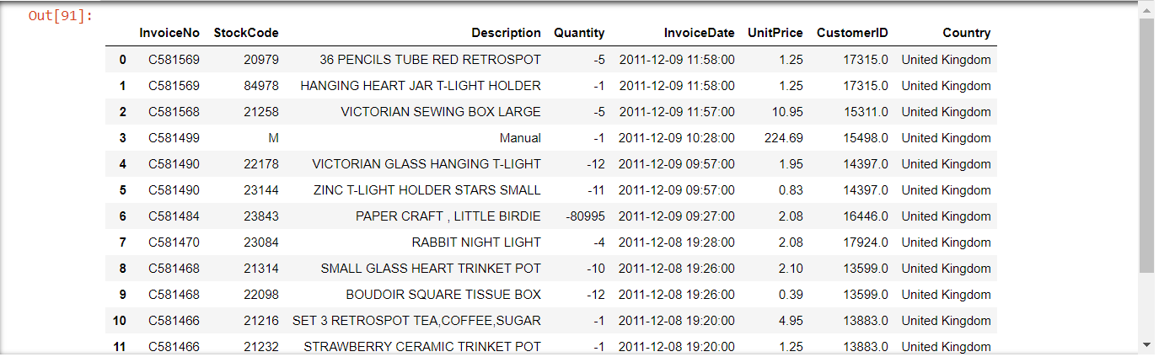
Raw Data

Slide 4
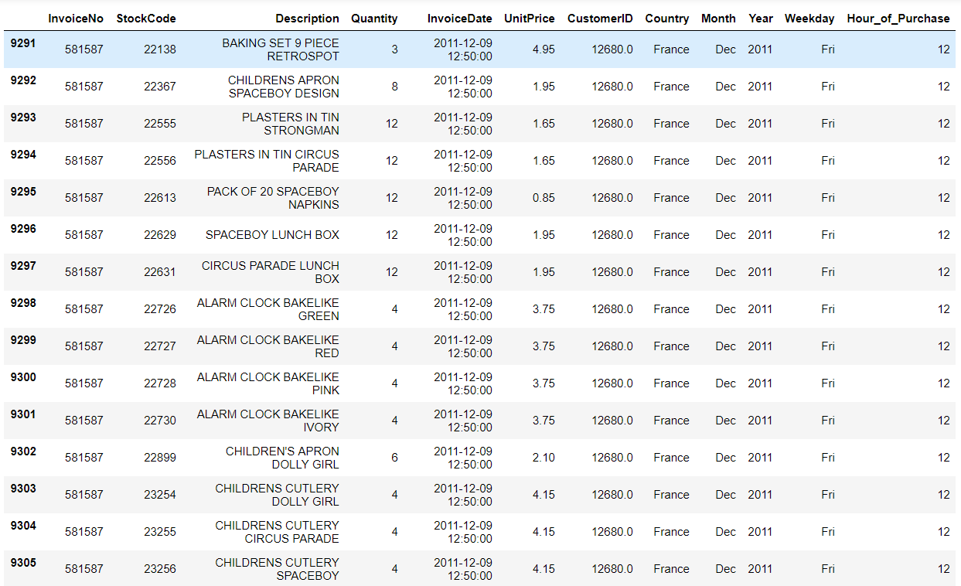
Cleaned Data
The dataset contains 529,733 transactions.
For details on data cleaning, visit my GitHub project file - Market Basket Analysis

Slide 5
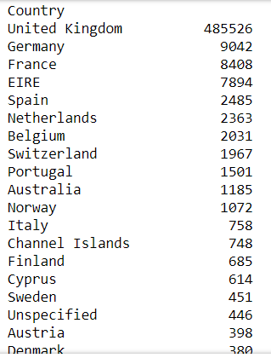
Country information
As we can see in the table, most of the purchases are made from the United Kingdom and is our primary market in the Europe.
It is followed by Germany, France and Ireland.

Slide 6
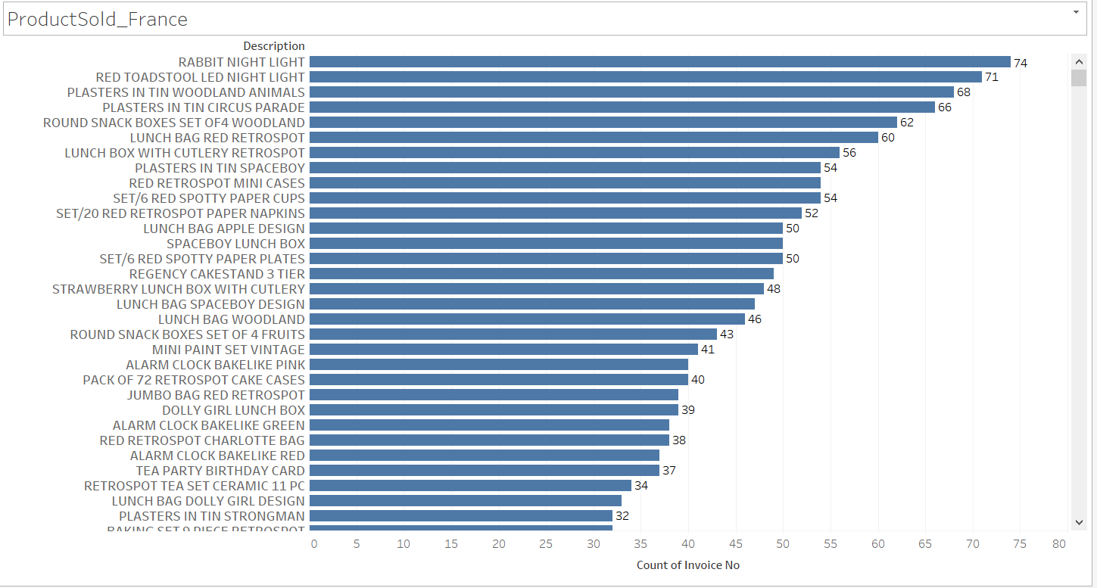
Analysis on France
In the above graph we observe the highest selling products in France.

Slide 7
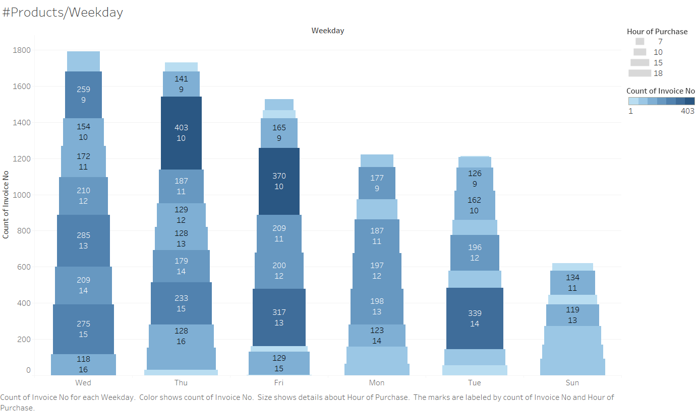
Analysis on France
In the above heatmap, we observe that maximum customers are at 10 am on Thursday and Friday. Sunday has the minimum customers, so may be an offer on Sunday might boost sales on that day.

Slide 8
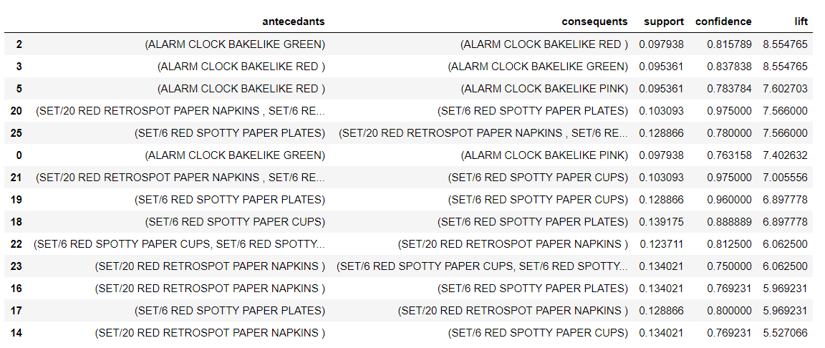
Analysis on France
Market Basket Analysis
For analysis details on Python codes, visit my GitHub project file - Market Basket Analysis

Slide 9
Analysis on France
As we can see for rules in RuleID = 25 (previous slide) as well as few others, the trend of buying Paper plates, paper cups and paper napkins is quite often. And this is intuitive enough that people would tend to buy a whole set of disposable items.
The support of [SpottyPaperPlates => (SpottyPaperCups, SpottyPaperNapkins)] is 12.88% [~50/392]. This shows that this combination of purchasing is done 50 times out of total 392 total invoices in France.
The Confidence in the rule, i.e., the probability of purchasing (Cups, Napkins) after a prior purchase of (Plates) made is 0.78.
LIFT is the overall metric that summarizes the purchasing rule and provides a single number which indicates its importance. Mathematically speaking, it shows the Statistical Dependence/Independence of the item sets.
A lift of 1 shows that the item sets are independent and buying antecedent (Plates) item does not affect in buying the consequent (Cups, Napkins) and the consequent purchase is just random. A lift greater than 1, shows statistical dependency and so it is more likely that customers but consequent item once antecedent item is purchased. Higher the Lift, better is the rule.
LIFT = [CONFIDENCE IN THE RULE] / [SUPPORT OF THE CONSEQUENT]

Slide 10
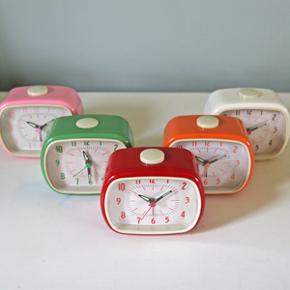
Analysis on France
Also, there is some trend in buying different colored alarm clocks. Customers from France tend to purchase a set of alarm clocks of different colors. Most likely bought colors are [Red, Green, Pink].
Thus we can give a combo offer which would lead to further sales of colored clocks. Additionally, other colors might be combined with an offer, and it seems that people would most likely buy upon an offer.
Considering the RuleID: 2,
[GreenClock => RedClock]
Support = 9.79% [38/392]
Confidence (probability of buying Red once Green is purchased) = 0.81
Lift = 8.55

Slide 11
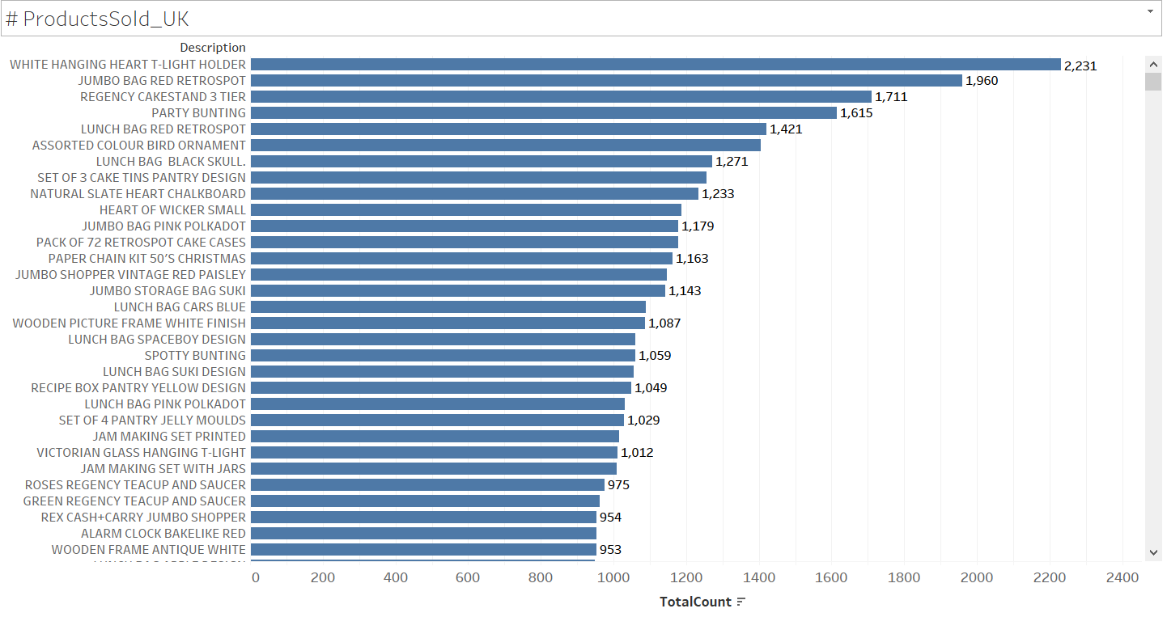
Analysis on the United Kingdom
In the above graph we observe the highest selling products in the UK.

Slide 12
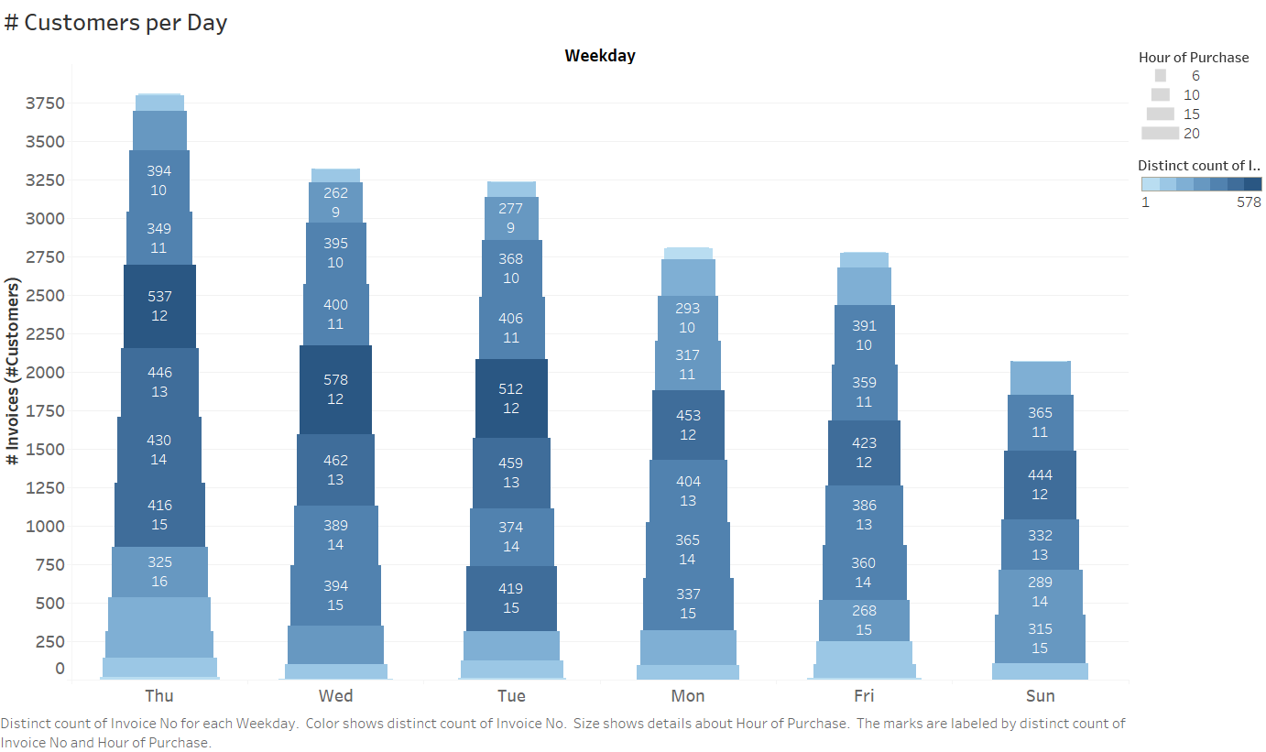
Analysis on the United Kingdom
In the above heatmap, we observe that maximum customers are during 11 am to 3 pm. Purchasing trend is fairly even in the afternoon on all days.

Slide 13
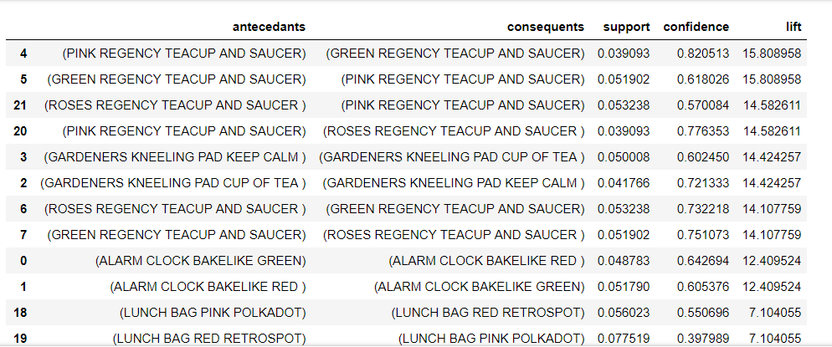
Analysis on the United Kingdom
Market Basket Analysis

Slide 14
Analysis on the United Kingdom
There are total 18,058 invoices for the United Kingdom.
For the United Kingdom, the data shows that there is a trend of purchasing different colored teacup and saucers together.
Moreover, data trend shows that British love tea items, so I would recommend to pair the different colored teacups and accessories together and bundle them.
As we see in the above rules, consider the RuleID 5, the support is high of 5.1% [921 times purchased together]. Also, other colored teacups have good support as well as confidence. So we can assume that bundling would do good.
[Green Teacup and Saucer => Pink Teacup and Saucer]
Support = 5.1% [921/18,058]
Confidence (probability of buying Pink once Green is purchased) = 0.61
Lift = 15.80

Slide 15
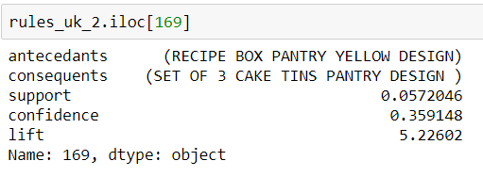
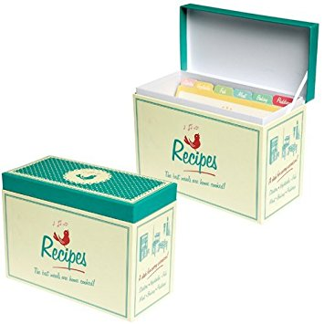
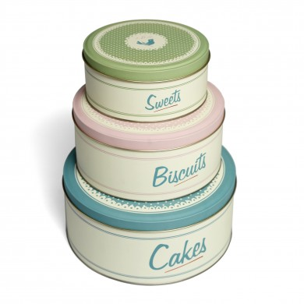
Analysis on the United Kingdom
Another insight from the data. We see the rule:
[RECIPE BOX PANTRY YELLOW DESIGN] => [SET OF 3 CAKE TINS PANTRY DESIGN]
Support = 5.72% [1029 times purchased together]
Confidence = 35%
Lift = 5.22 [Greater than 1 shows statistically dependent in a positive way]

Slide 16
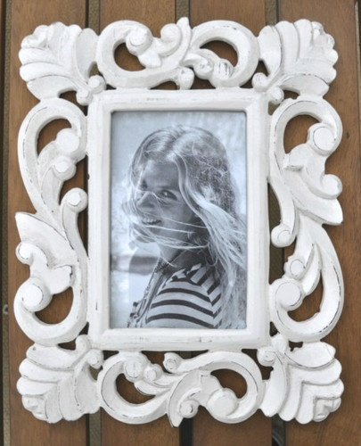
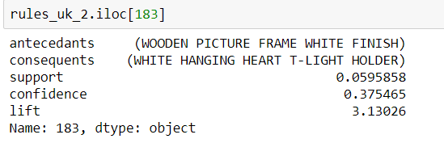

Analysis on the United Kingdom
Another insight from the data. We see the rule:
[WOODEN PICTURE FRAME WHITE FINISH] => [WHITE HANGING HEART T-LIGHT HOLDER]
Support = 5.95% ~~ 6.0 % [1083 times purchased together]
Confidence = 37%
Lift = 3.13 [Greater than 1 shows statistically dependent in a positive way]

Slide 17
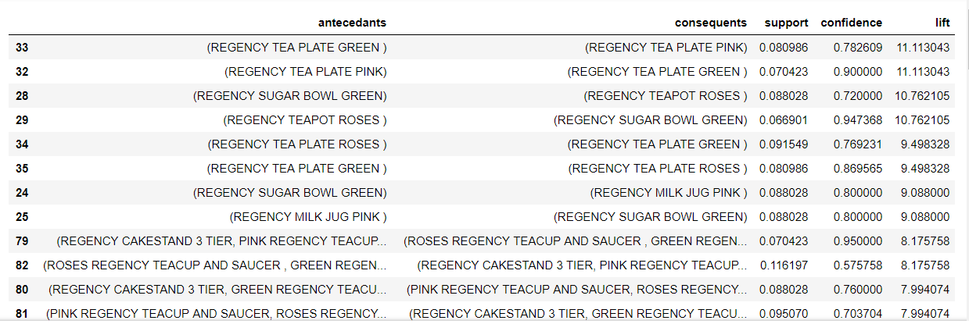
Analysis on Ireland
Market Basket Analysis

Slide 18
Analysis on Ireland
Two rules that are found a little interesting are:
TEAPOT => SUGAR BOWL
SUPPORT = 0.065 (19 invoices contained both the items out of 288)
CONFIDENCE = 0.947 (94.73% chances that once TEAPOT is purchased, customers also buy SUGAR BOWL)
LIFT = 10.91 (Much greater than 1 indicates that the two products are correlated in a positive way and statistically dependent)
MILK JUG => SUGAR BOWL
SUPPORT = 0.086 ( Almost 25 invoices contained both the items out of 288.
CONFIDENCE = 0.80 (80.00% chances that once MILK JUG is purchased, customers also buy SUGAR BOWL)
LIFT = 10.91 (Much greater than 1 indicates that the two products are correlated in a positive way and statistically dependent)

Slide 19
Additional Analysis Options
The tools used in the project were Python, Tableau and Machine Learning library from mlxtend.
As we have seen in the analysis, the UK is our largest market and bundling on certain items and giving offers on weekends might result in better sales. Further extension of analysis can be done related to it.
The data set also contains cancelled orders which can be further analyzed.
Germany also has a huge market and can be further analyzed in a similar way to gain insights on the purchasing pattern.
We have CustomerID recorded for some of the purchases. We can gather and study the online behavior pattern of users and then perform classification using machine learning library like Python’s sci-kit learn to predict whether the user will purchase an item or not.

Slide 20
Thank You for viewing the presentation.

